Slide 1

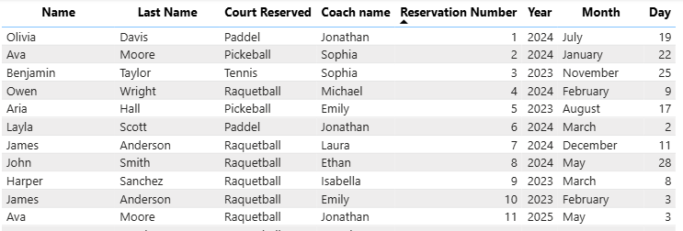
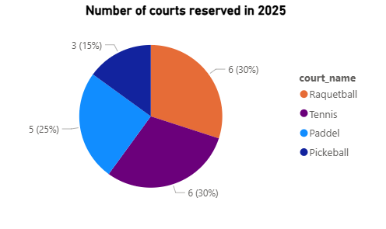
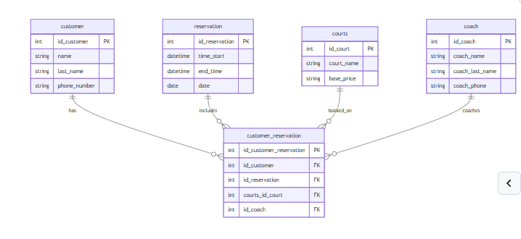
Raquet Club
he database is built around four normalized entities: coach, courts, reservation, and customer. Each table stores information related to the reservation of each customer.
The database is built around four normalized entities: coach, courts, reservation, and customer. Each table stores information related to the reservation of each customer.
Isabella Herrera| Huntington University | CS 415 Database Management – Fall 2025 - Final Project
Overview
Data
Reports
Company based in Fort Wayne that specializes in sports involving racquets, such as Tennis, pickleball, Paddle, and racquetball.
The club offers multiple courts and coaching sessions for clients of all ages and experiences.
The primary users of this database will be the company's analyst, financial team and service personnel.
User’s perspective
The service personnel can quickly view customers' upcoming courts and times, history, profile and weather a customer is new or returning. They can also check the availability of coaches, and identify open time slots for walk in sessions or last-minute appointments.
allow the staff to create meaningful reports for management
Coach
Id_coach
Courts
Courts_id_courts
Reservation
Id_reservation
Customer
Id_customer
Customer_reservation
Id_customer_reservation
Each table stores normalized, non-duplicated information that allows every reservation to be properly linked to complete customer, court, and coach details. Each table includes a primary key (PK), which is referenced as a foreign key (FK) in the reservation table. This structure ensures accurate relationships between tables and maintains data integrity across the entire system.
Database Design
Coach
Personal information about the coaches: name, last name, and phone number.
Courts
The courts table stores the courts_name and base_price. The base price is the amount the customer pays.
Reservation
The reservation table stores the start time, end time, and the date the reservation is occurring.
Customer
The customer table stores all the private information of the customer: first name, last name, and phone number.
Customer_reservation
This is the central table used to retrieve information about each customer reservation. This table stores four foreign keys from all other tables, allowing it to connect all the parts of the reservation.
Queries
-- Query 4: Count reservations per customer and show only those with more than 2 reservations
SELECT id_customer, COUNT(id_reservation) AS total_reservations
FROM customer_reservation
GROUP BY id_customer
HAVING COUNT(id_reservation) > 2;
-- Query 5: Join reservation, customer, coach, court to show reservations without coach
SELECT
a.id_reservation,
CONCAT(b.name, " ", b.last_name) AS "Customer",
c.court_name,
c.base_price,
CONCAT(d.coach_name, " ", d.coach_last_name) AS "Coach"
FROM customer_reservation AS a
JOIN customer AS b ON a.id_customer = b.id_customer
JOIN courts AS c ON a.courts_id_court = c.id_court
JOIN coach AS d ON a.id_coach = d.id_coach
LIMIT 20;
If we use left join then we can see all the reservations even if coach is NULL
-- Query 9: Create a view and then using it
CREATE VIEW total_revenue AS
SELECT
a.courts_id_court AS courts_id_court,
c.court_name AS court_name,
SUM(c.base_price) AS Total_Revenue
FROM customer_reservation AS a
JOIN courts AS c
ON a.courts_id_court = c.id_court
GROUP BY
a.courts_id_court,
c.court_name;
-- Use the view
SELECT * from total_revenue;
Chart #1
Displays detailed reservation information, including the customer’s first and last name, the court reserved, whether a coach was required, and the full reservation date (year, month, and day)
Chart #2
Represents the number of courts reserved by customers in the year 2025. This visualization is useful for identifying trends across the three sports offered and helps determine which one is the most popular.
ER Model
Future Work
Several opportunities exist for future development of this project.
Implementing stored procedures or triggers to automatically calculate reservation pricing would improve consistency and reduce human error.
Data constraints, such as preventing double booking of courts or coaches, would strengthen data integrity.
Expanding the system to include payment management, membership tiers, and automated billing would create a more complete operational environment.
integrating a user interface or reporting module would support staff decision-making by providing real-time access to schedules, usage statistics, and customer information.
Works Cited
OpenAI. (2025). ChatGPT (GPT‑5.1) [Modelo de lenguaje]. https://chat.openai.com

